Slide 1

Knowledge Assistant using RAG
By,
Sindhu L

Slide 2
Table of Contents
Problem Statement
Why RAG
Approach
Ingestion Pipeline
Retrieval Pipeline
Results
Conclusion

Slide 3
Problem Statement
This project aims to build a Retrieval-Augmented Generation (RAG) based Knowledge Assistant using open-source tools that retrieves relevant document content before generating responses.
The system ensures that answers are generated strictly from the provided documents by implementing a complete RAG pipeline, including ingestion, embedding, vector search, and response generation.

Slide 4
Why RAG?
LLMs generate answers from learned patterns, not from specific documents, making them prone to hallucinations and weak document grounding.
LLMs struggle to handle large, domain-specific knowledge bases and cannot reliably identify the most relevant context for a query.
RAG retrieves and injects relevant document context before generation, enabling accurate, grounded, and domain-specific responses.

Slide 5
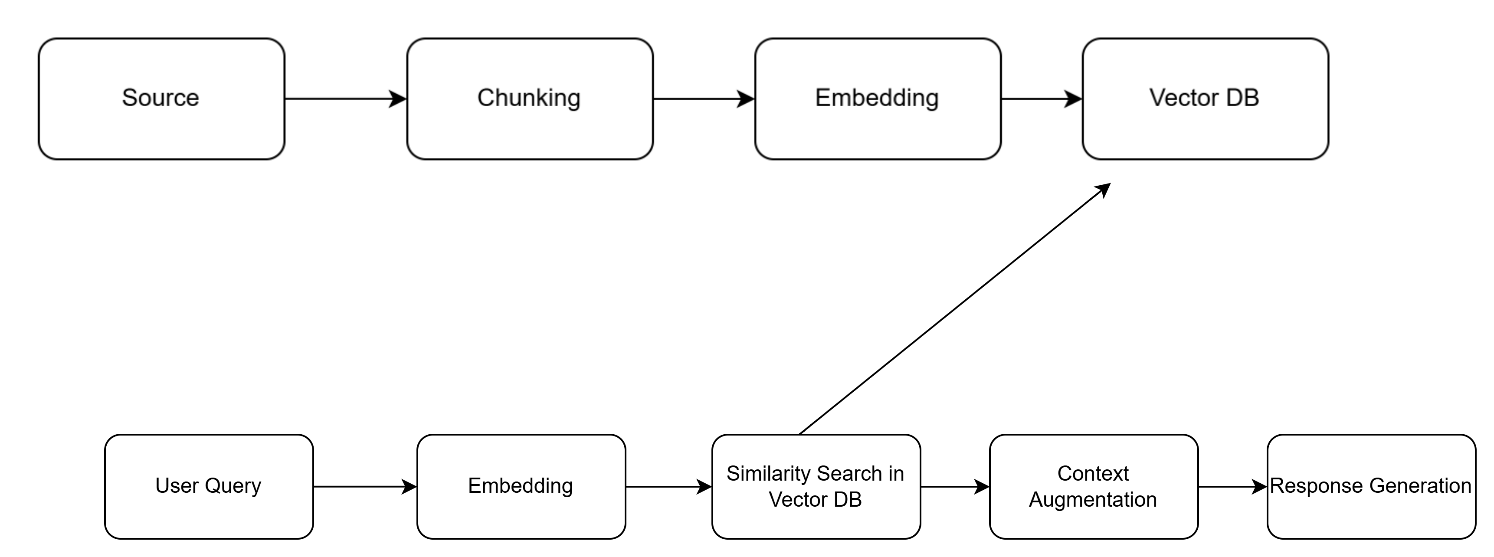
Approach
Ingestion Pipeline
Retrieval Pipeline

Slide 6
Ingestion Pipeline
Framework
  LangChain: Orchestrates the end-to-end RAG pipeline, integrating document loading, chunking, embedding, and retrieval.
Chunking
  RecursiveCharacterTextSplitter (LangChain): Performs context-aware, hierarchical text splitting to preserve semantic coherence.
Embeddings
  Sentence Transformers (via Hugging Face in LangChain): Generate dense transformer-based semantic embeddings for accurate similarity retrieval.
Vector Database
  Chroma (LangChain integration): Provides a lightweight, efficient vector store for fast similarity search in the RAG system.

Slide 7
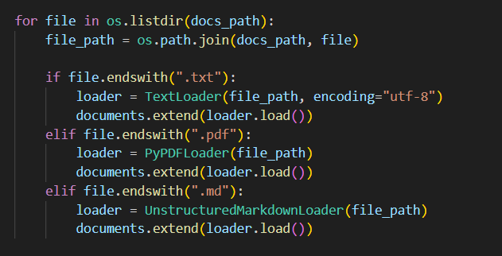
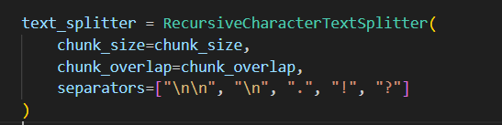
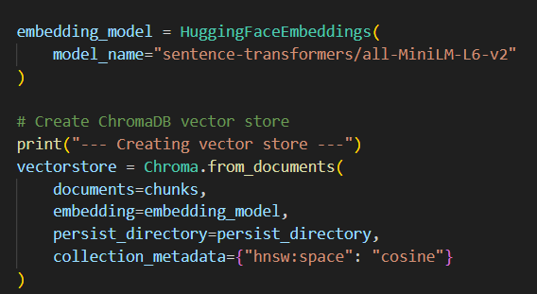
Loading the Documents
Chunking
Embedding and Vector DB Storage

Slide 8
Retrieval Pipeline
Similarity Search
  Cosine similarity : Identifies semantically closest chunks in high-dimensional vector space.
Relevance Filtering
  Score threshold = 0.4 (Top-K = 5): Filters low-confidence matches to reduce noise and hallucinations.
Context Augmentation
  Concatenation of retrieved chunks: Injects relevant document context into the prompt for grounded responses.
Prompt Control
  Strict context-only prompt: Forces the LLM to answer solely from retrieved content or respond with “I don’t know”.
Response Generation
  TinyLLaMA via LlamaCpp (local inference): Generates low-latency, privacy-preserving answers using augmented context.

Slide 9
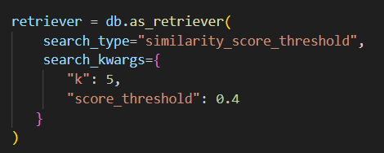
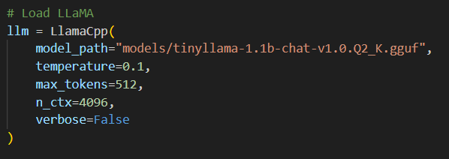
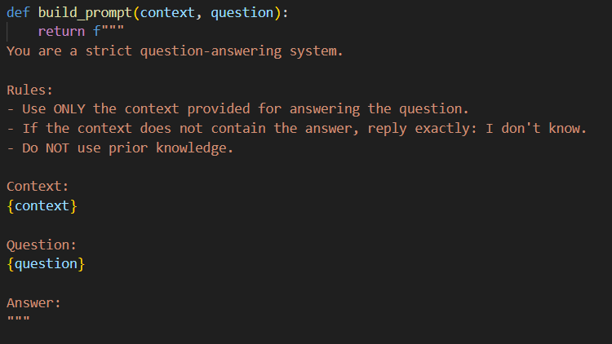
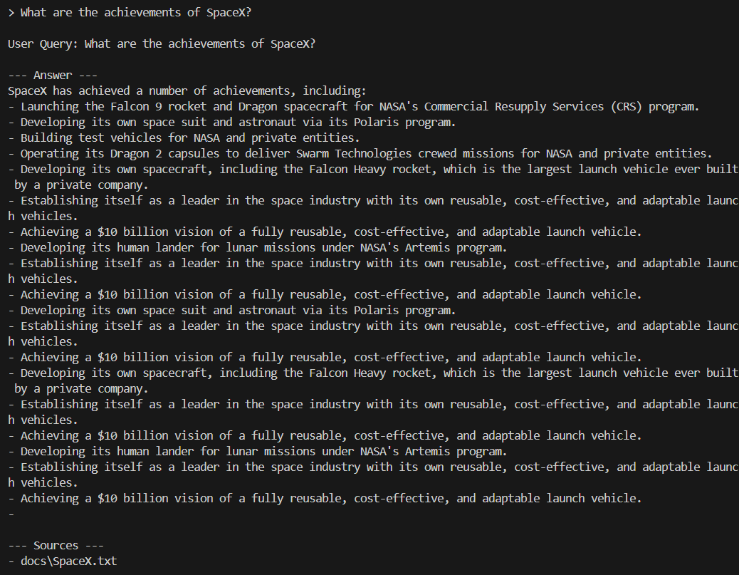
Retriever: with score threshold 0.4
LLM Initialization
Context Augmentation and Prompt Control
Result Generation along with Source details

Slide 10
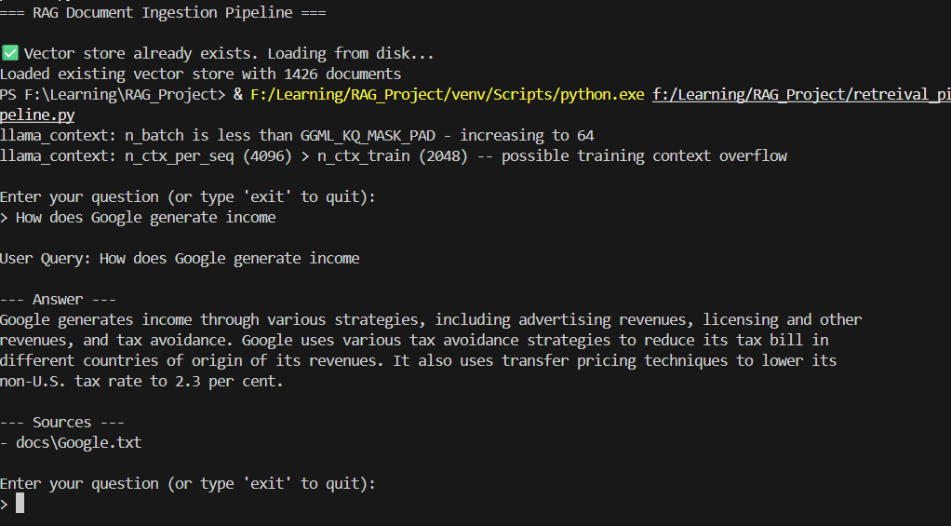
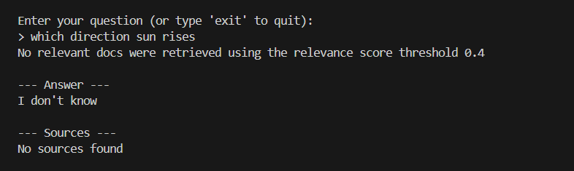
Results
Response Generation for User Query with Source of the document
Response Generation for User Query which is out of context
The knowledge assistant correctly answers questions when the answer exists in the retrieved context.
If the answer is not in the context, it responds with “I don’t know”, avoiding hallucinations.
This shows that the RAG pipeline is working as intended, reliably grounding responses in source documents.

Slide 11
Conclusion
Successfully designed and implemented an end-to-end Retrieval-Augmented Generation (RAG) pipeline using LangChain.
Employed recursive chunking and sentence-transformer embeddings to enable accurate semantic retrieval from unstructured documents.
Integrated Chroma vector database with cosine similarity and threshold-based filtering to retrieve high-quality, relevant context.
Utilized a local LLaMA model (TinyLLaMA via LlamaCpp) to generate grounded, context-aware responses while minimizing hallucinations.
Demonstrated an efficient, scalable, and privacy-preserving RAG system suitable for real-world document question-answering tasks.

Slide 12
Thank You

